Slide 1
A core Course on Modeling
Introduction to Modeling
0LAB0 0LBB0 0LCB0 0LDB0
c.w.a.m.v.overveld@tue.nl
v.a.j.borghuis@tue.nl
S.23

Slide 2
Execution phase: operate model
define
formulate
purpose
conceptualize
identify
entities
choose
relations
formalize
obtain
values
formalize
relations
execute
operate
model
obtain
result
conclude
present
result
interpret
result
Notes:
2

Slide 3
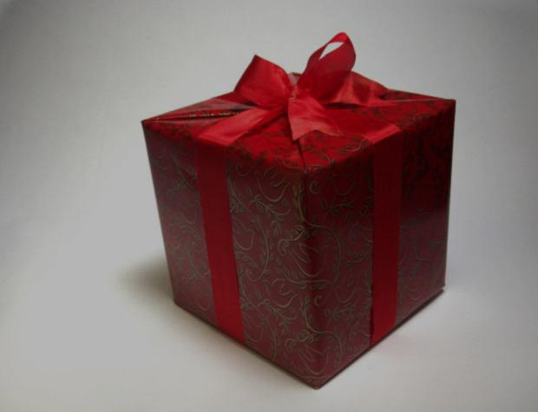
The model function maps decisions (=values for cat.-I quantities)
to their consequences for the stakeholders.
Everything the model should yield for stakeholders, is a criterion on cat.-II quantities.
http://cdn.morguefile.com/imageData/public/files/m/mconnors/preview/fldr_2003_12_31/file0001135069634.jpg
Notes:
3

Slide 4
Don’t include too many cat.-II quantities;
because ...
lumping: too many dubious weight factors
no lumping: see next lecture
Include the right cat.-II quantities;
Cat.-II quantities for design etc. must be ordinal;
Cat.-II quantities must be SMART.
S = specific
M = measurable
A = acceptable
R = realistic
T = timely
Notes:
4

Slide 5
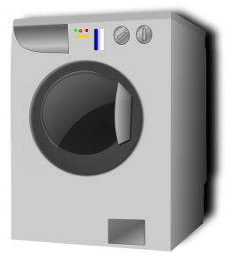
Regarding SMART-ness:
Even ‘hard’ quantities (e.g., energy consumption, waste production, noise, …) often require non-trivial operationalization.
example of operationalization:
what is the energy consumption of a washing machine?
http://www.clipartlord.com/wp-content/uploads/2013/07/snail3-240x240.png
http://www.clipartlord.com/category/home-clip-art/appliances-clip-art/washing-machine-clip-art/
Notes:
5

Slide 6
Regarding SMART-ness:
Even ‘hard’ quantities (e.g., energy consumption, waste production, noise, …) often require non-trivial operationalization.
QUIZ
What would be the consequences of optimizing a washing machine with respect to ...
joule/Hour
joule/wash
joule/(kg wash)
joule/(lifetime of a piece of laundry)
joule/(lifetime of the washing machine)?
example of operationalization:
what is the energy consumption of a washing machine?
http://www.clipartlord.com/wp-content/uploads/2013/07/snail3-240x240.png
http://www.clipartlord.com/category/home-clip-art/appliances-clip-art/washing-machine-clip-art/
Notes:
6

Slide 7
Regarding SMART-ness:
Even ‘hard’ quantities (e.g., energy consumption, waste production, noise, …) often require non-trivial operationalization.
example of operationalization:
what is the energy consumption of a washing machine?
Joule/Hour?
http://www.clipartlord.com/wp-content/uploads/2013/07/snail3-240x240.png
http://www.clipartlord.com/category/home-clip-art/appliances-clip-art/washing-machine-clip-art/
Notes:
7

Slide 8
Regarding SMART-ness:
Even ‘hard’ quantities (e.g., energy consumption, waste production, noise, …) often require non-trivial operationalization.
http://www.clipartlord.com/wp-content/uploads/2012/12/red-socks-300x269.png
example of operationalization:
what is the energy consumption of a washing machine?
Joule/Hour?
Joule/wash?
http://www.clipartlord.com/category/home-clip-art/appliances-clip-art/washing-machine-clip-art/
Notes:
8

Slide 9
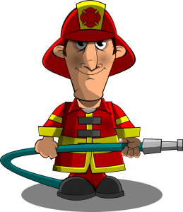
Regarding SMART-ness:
Even ‘hard’ quantities (e.g., energy consumption, waste production, noise, …) often require non-trivial operationalization.
http://www.clipartlord.com/wp-content/uploads/2012/11/fireman-259x300.png
example of operationalization:
what is the energy consumption of a washing machine?
Joule/Hour?
Joule/wash?
Joule/(kg wash)?
http://www.clipartlord.com/category/home-clip-art/appliances-clip-art/washing-machine-clip-art/
Notes:
9

Slide 10
Regarding SMART-ness:
Even ‘hard’ quantities (e.g., energy consumption, waste production, noise, …) often require non-trivial operationalization.
http://www.clipartlord.com/wp-content/uploads/2013/07/meat-grinder-227x240.png
example of operationalization:
what is the energy consumption of a washing machine?
Joule/Hour?
Joule/wash?
Joule/(kg wash)?
Joule/(lifetime of the piece of laundry)?
http://www.clipartlord.com/category/home-clip-art/appliances-clip-art/washing-machine-clip-art/
Notes:
10

Slide 11
Regarding SMART-ness:
Even ‘hard’ quantities (e.g., energy consumption, waste production, noise, …) often require non-trivial operationalization.
example of operationalization:
what is the energy consumption of a washing machine?
Joule/Hour?
Joule/wash?
Joule/(kg wash)?
Joule/(lifetime of the piece of laundry)?
Joule/(lifetime of the washing machine)?
http://www.clipartlord.com/wp-content/uploads/2012/11/nuclear-explosion-249x300.png
http://www.clipartlord.com/category/home-clip-art/appliances-clip-art/washing-machine-clip-art/
Notes:
11

Slide 12
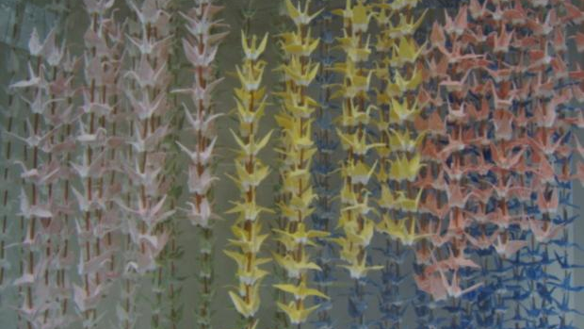
Cat.-II quantities and requirements, desires, wishes
Terminology:
proposition=sentence that is true or false (‘tomato is red’);
predicate=proposition over a concept (‘isRed(tomato)=true’);
Requirement=predicate over a concept that needs to hold;
Desire=predicate over a concept that is appreciated.
http://www.morguefile.com/archive/display/108211
Notes:
12

Slide 13
Cat.-II quantities and requirements, desires, wishes
A third condition-type is the wish:
‘cat.-II quantity q should be as large (small) as possible’.
This, however, is impossible to achieve: it would require all possible outcomes to compare with.
Weaker version:
‘q should approximate the max (min) as achievable in the cat.-I space’.
Notes:
13

Slide 14
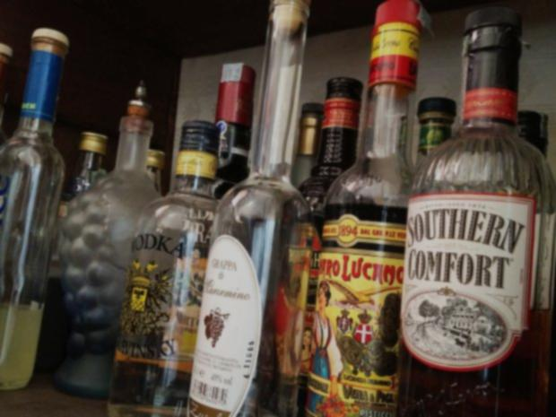
Example: an evening in the bar
E=MSM+MSF;euro money spent: should be minimal
L=L0-(Q*R+GTT);minute lonely minutes: should be minimal
MSF=P*V*R*cons;euro money spent on rounds
cons=1;glass/friend.round
http://www.morguefile.com/archive/display/803730
Notes:
14

Slide 15
Example: an evening in the bar
E=MSM+MSF;euro money spent: should be minimal
L=L0-(Q*R+GTT);minute lonely minutes: should be minimal
MSF=P*V*R*cons;euro money spent on rounds
cons=1;glass/friend.round
QUIZ
http://www.morguefile.com/archive/display/803730
What is expressed by cons=1 ?
What happens if we leave out the factor cons from MSF=P*V*R*cons?
Notes:
15

Slide 16
Example: an evening in the bar
E=MSM+MSF;euro money spent: should be minimal
L=L0-(Q*R+GTT);minute lonely minutes: should be minimal
MSF=P*V*R*cons;euro money spent on rounds
cons=1;glass/friend.round
one friend gets one drink in one round
MSM=P*G;euro money spent on drinking alone
P=2.25;Euro/glass price of one drink
V=7;friend nr of friends
http://www.morguefile.com/archive/display/803730
Notes:
16

Slide 17
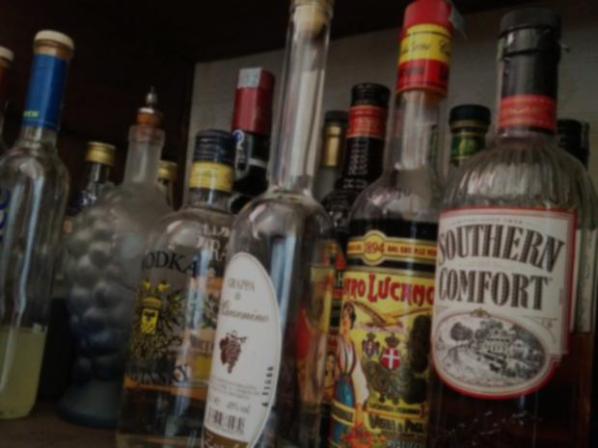
Example: an evening in the bar
R=0 ... 10;round nr rounds I buy
G=0 ... 20;glass nr of drinks I buy for myself
Q=15;minute/round amount of talk time per round
L0=360;minute length of an evening
GTT=max(zero,maxTalkTime*(optNrGlasses²- (G-optNrGlasses)²)/optNrGlasses²)
http://www.morguefile.com/archive/display/803730
Notes:
17

Slide 18
Example: an evening in the bar
R=0 ... 10;round nr rounds I buy
G=0 ... 20;glass nr of drinks I buy for myself
Q=15;minute/round amount of talk time per round
L0=360;minute length of an evening
GTT=max(zero,maxTalkTime*(optNrGlasses²- (G-optNrGlasses)²)/optNrGlasses²)
http://www.morguefile.com/archive/display/803730
QUIZ
GTT represents talk time due to my own consumption of alcohol.
How does GTT depend on G?
Why do we want that?
Notes:
18

Slide 19
Example: an evening in the bar
R=0 ... 10;round nr rounds I buy
G=0 ... 20;glass nr of drinks I buy for myself
Q=15;minute/round amount of talk time per round
L0=360;minute length of an evening
GTT=max(zero,maxTalkTime*(optNrGlasses²- (G-optNrGlasses)²)/optNrGlasses²) amount of time I can talk depening on what I drink
That is: how my eloquence depends on nr drinks I had.
http://www.morguefile.com/archive/display/803730
Notes:
19

Slide 20
Example: an evening in the bar
maxTalkTime=63;minute max talk time if I drink exactly enough
optNrGlasses=3;glass optimal number of glasses for me to drink
zero=0;minute to make GTT dimensionally correct
Notice:
cons=1 and zero=0 are necessary to make dimensions match
http://www.morguefile.com/archive/display/803730
Notes:
20

Slide 21
Summary:
choose cat.-II definitions with care
three varieties of directions for optimality
requirement (must have)
desire (nice-to-have)
wish (unbounded: ‘as ... as possible’)
need for value-less, but not unit-less factors or terms in expresions
Notes:
21

